Slide 1
Introduction to Python
Adam Watts
USPAS January 2025, Knoxville
Python Programming and Applications for Accelerator Science and Engineering

Slide 2
Meet and Greet
Dan Green
MATLAB / Physics Instructor
Jeff Eldred
Python / Programming Instructor
Adam Watts
Python / Programming TA
Introduce Yourself
Name
Affiliation
Interest in this Course
Anything else you’d like to share

Slide 3
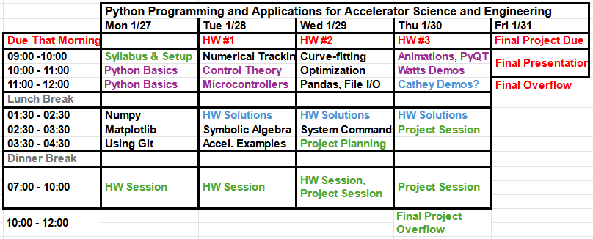
Schedule, Syllabus, Grading
Eldred Lectures
Watts Lectures
Cathey Lecture
HW Solutions
At Brandon's discretion, late HW may be accepted with penalty, up until HW Solution presented.
Student Session
At least two instructors should be available to help. Jeff & Adam take point until grading is finished, then Brandon takes point while instructors work on lectures.
Student final project topics should be validated on Wed afternoon
Student Deadlines
HW due at the start of class.
Wed night is half-homework, half project work.
Final project presentations are 5min each, 24 x 5min = 2hours
Homework 70% (10%+20%+20%+20%) Final Project 30%
Syllabus
The Basics – interpret vs scripting, basic coding operations, numpy
Plotting – matplotlib, 2D colormap, histograms
Statistical / Analytical Tools – random numbers, percentiles, FFTs
Numerical Integration – tracking simulations
Control of Dynamic Systems
Symbolic Variables – declaring, differential equations, matrices
Optimization – general minimization, curve fitting
File Input & Output – csv files, pandas, text parsing, running system commands
PyQT – GUIs, mouse/keyboard input
Textbook: "Numerical Methods for Physics" second, revised Python edition by Alejandro L. Garcia (2017) CreateSpace Independent Publishing Platform.

Slide 4
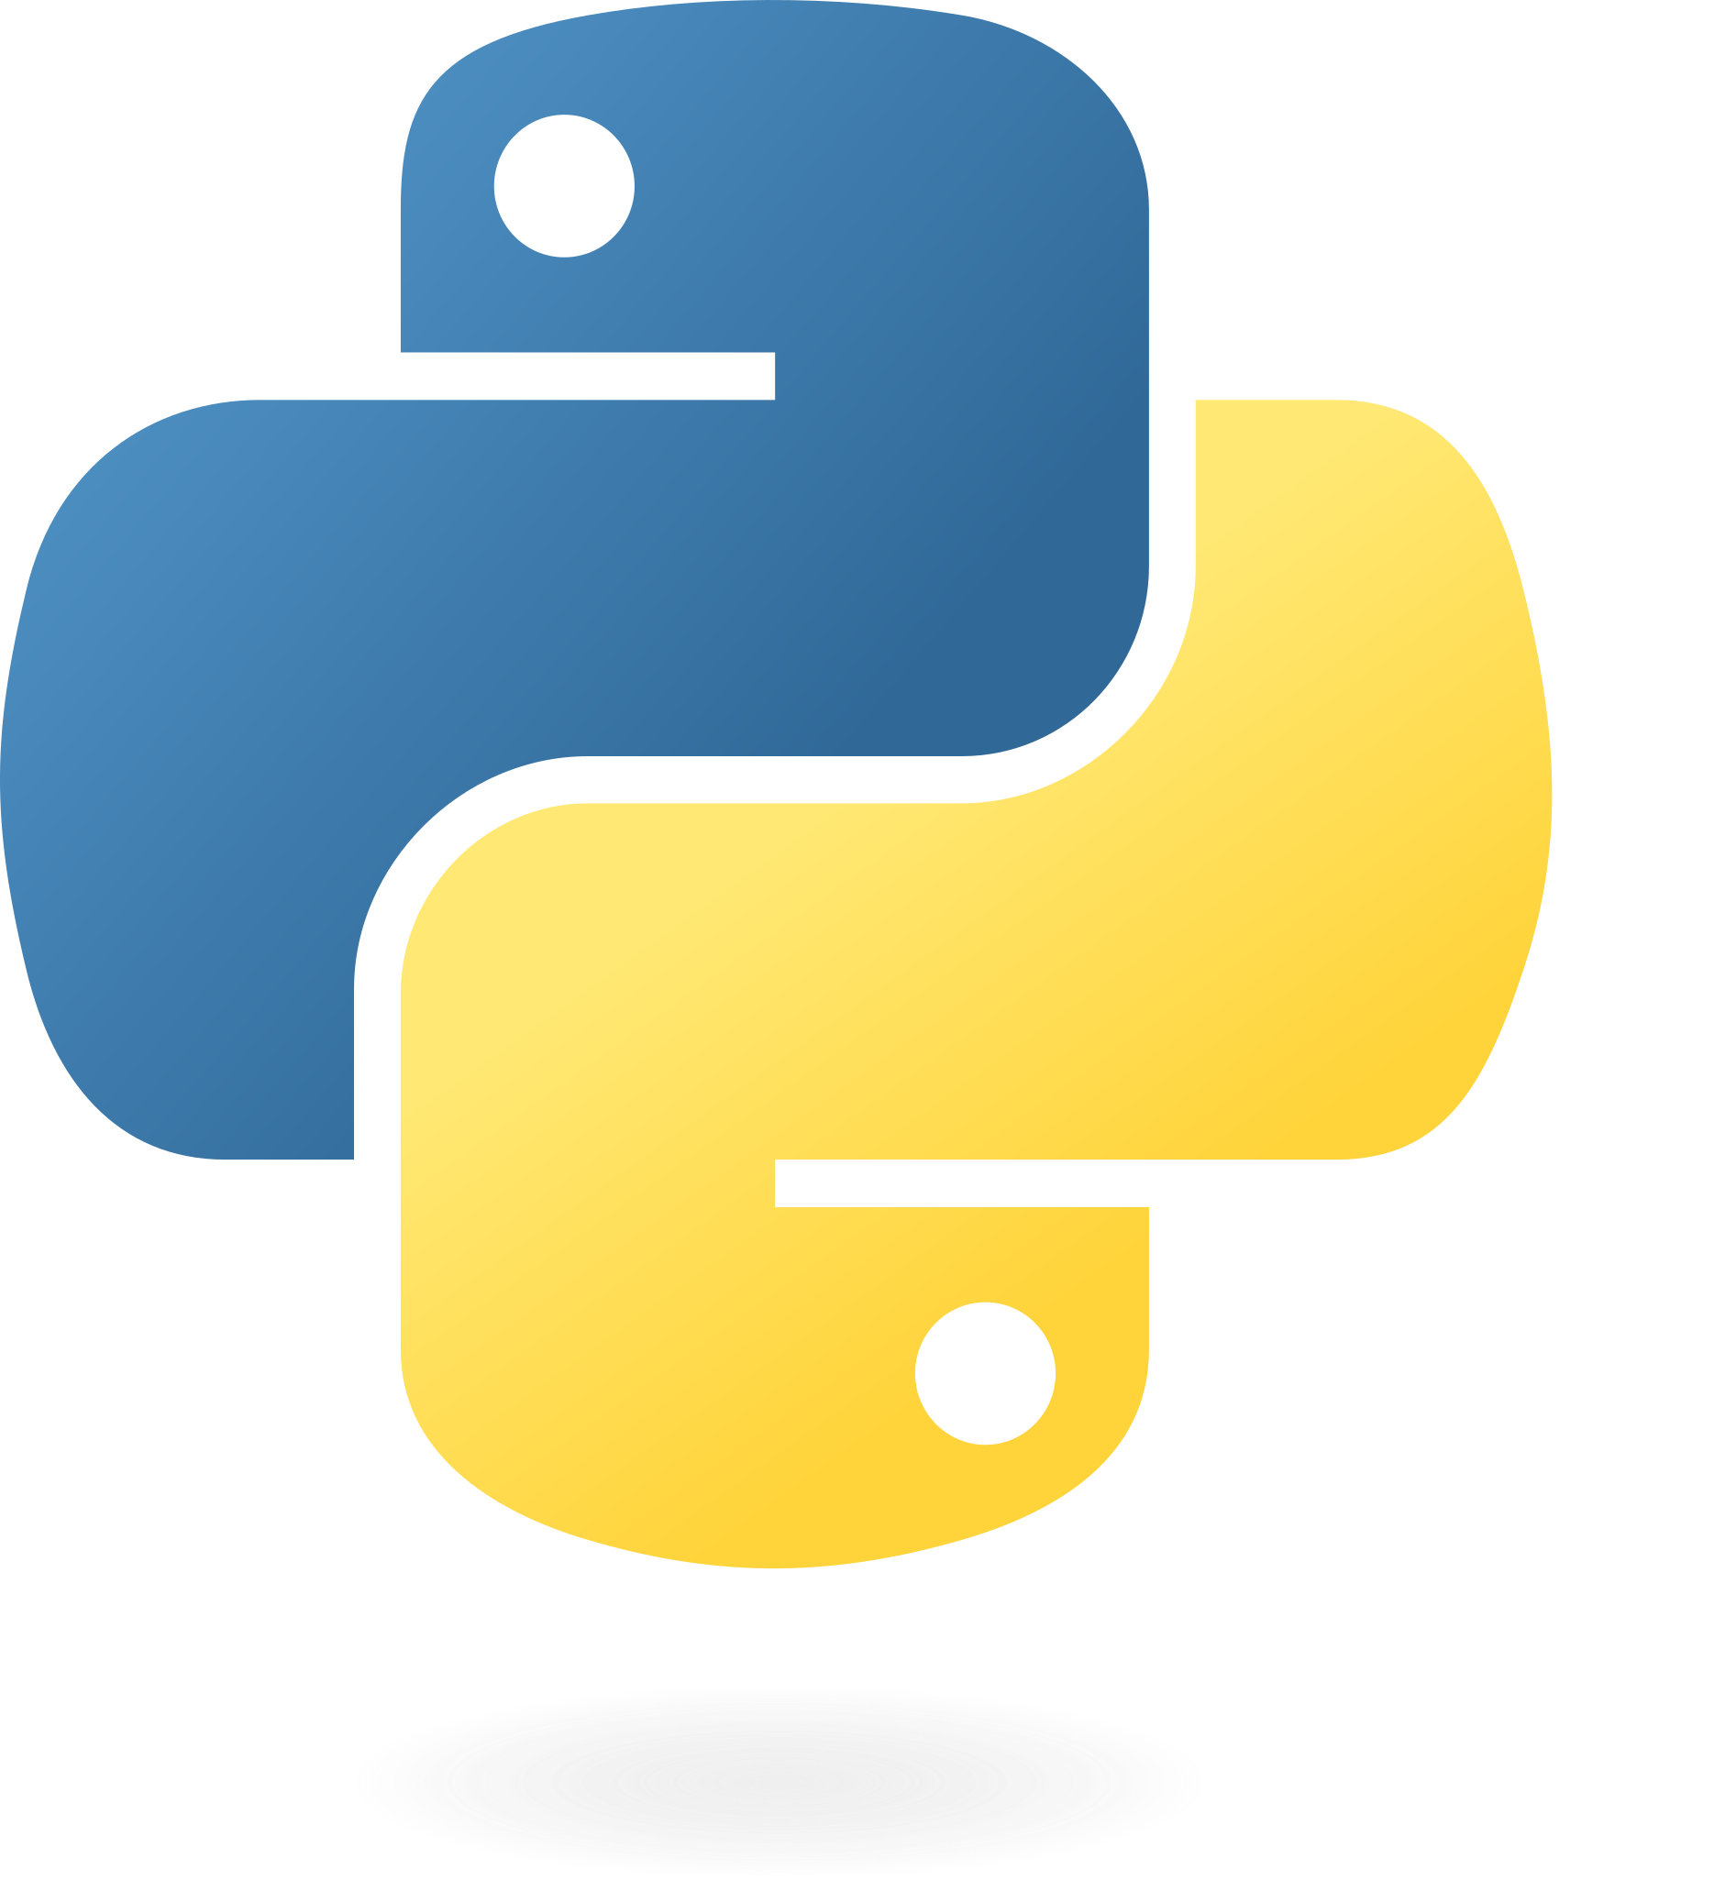
Outline
Why Python?
Installation and runtime
Fundamental syntax and structure
Control structures
File I/O
Libraries and dependencies
Environments, virtual-env, pyenv
Quirks unique to Python
Common pitfalls

Slide 5
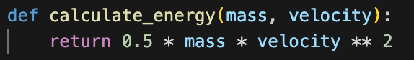
Why Python?
Readable Syntax: Python’s syntax is clear, concise, and close to natural language, making it easier to write, read, and debug code.
Interactive Environment: Python supports interactive development through tools like Jupyter Notebooks and a command-line interpreter, where you can experiment with small code snippets, visualize results in real-time, and document your process.
IDE (integrated development environment), such as VSCode or Spyder.
Command line interpreter allows for quick one-off tests to check functionality.
Jupyter notebooks provide Mathematica-like functionality to mix formatted Markdown text, images, animations, and blocks of Python code.

Slide 6

Why Python?
Quick Experimentation: Python is interpreted and dynamically-typed, good for quick experimentation; no need to compile.
Ecosystem for Scientific Computing: Specialized libraries for scientific computing, simulation, and data analysis:
NumPy: For fast numerical computations (e.g., large-scale data analysis, matrix operations).
SciPy: For optimization, integration, and solving differential equations (e.g., used for modeling and control systems).
Matplotlib, Plotly, Seaborn: For visualization, essential for analyzing and presenting complex data from particle detectors or accelerator parameters.
Pandas: For data manipulation, especially useful when dealing with large datasets from experiments or accelerators.
Scikit-learn, TensorFlow, PyTorch, OpenCV: For machine learning and computer vision.
PyOrbit, PyBeam, Synergia: For particle accelerator optics and dynamics simulation.

Slide 7
Why Python?
Full-stack flexibility
Graphical user interfaces (GUIs): Tkinter and PyQT for OS-native GUI, Dart/Flutter or Flask for web-based user interfaces.
Network communication: Low-level TCP/UDP with the socket and scapy libraries, HTTP/HTTPS with the requests or http.client library, and SSH with the paramiko library.
Hardware interfaces: Libraries such as PyVISA, PyDAQmx, and pyserial all allow Python to communicate with laboratory equipment over GPIB, Ethernet, USB, and serial links like RS-232 or RS_485.
Single-board Linux computers: Control over the general-purpose input/output (GPIO) functionality of Raspberry Pi computers via the RPiGPIO library.
Microcontroller firmware: MicroPython and CircuitPython to program microcontrollers without the need for low-level languages like Assembly or C.

Slide 8
Installation and Runtime: Command line
Download the installation package for your operating system from https://www.python.org/downloads/
Use the latest Python 3 version.
Create a “.py” file with Python code in a simple text editor (no rich-text formatting).
Depending on your installation, invoking Python from the command line may involve either typing “python” or “python3”.
In the terminal, navigate to the location of your “.py” file and run “python filename.py” to execute.
We recommend an integrated development environment like VSCode (later slides) for both authoring and executing Python scripts.

Slide 9
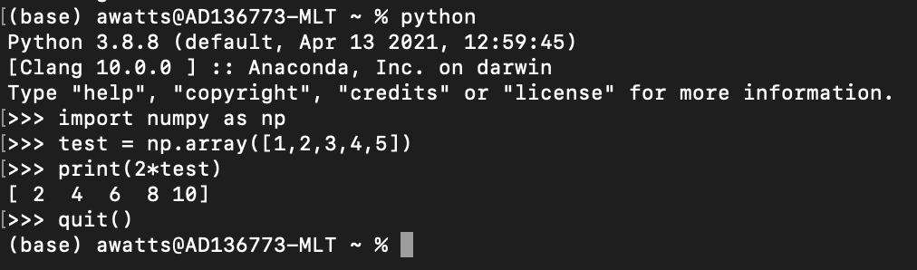
Installation and Runtime: Command Line Interpreter
Allows for real-time results from Python commands. Interactive session has its own memory, so variables and function definitions persists until “quit()” is entered to return to the terminal.
In a terminal, run the command “python” (or “python3”, depending on the installation specifics). Note that the interpreter tells you the Python version it’s using.
Enter and execute commands one line at a time. Good for checking library versions or running quick syntax tests.

Slide 10
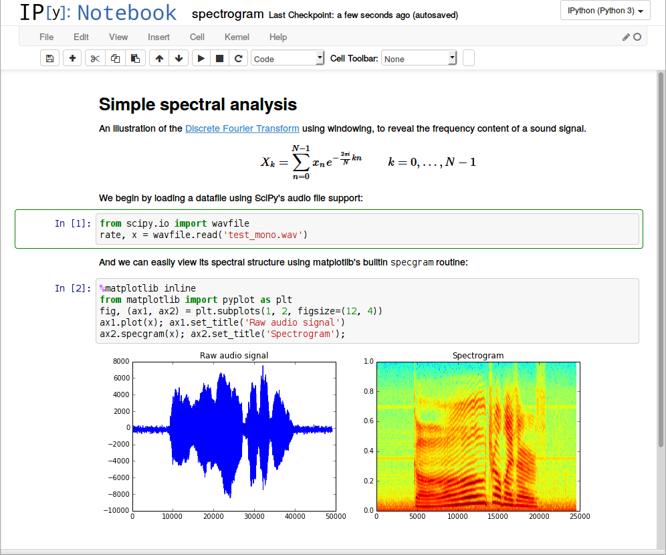
Installation and Runtime: Jupyter Notebook
Jupyter is a browser-based environment for interactive programming notebooks.
Once Python is installed, use the “pip” utility to install everything else: https://jupyter.org/install.
Notebook files have the “.ipynb” extension, and run in the web browser.
Formatted text with Markdown, inline equations, images, and plot outputs of Python code can all be embedded in a single notebook.
We recommend doing this all through the VSCode IDE instead (next slides).
Source: https://arogozhnikov.github.io/2016/09/10/jupyter-features.html

Slide 11
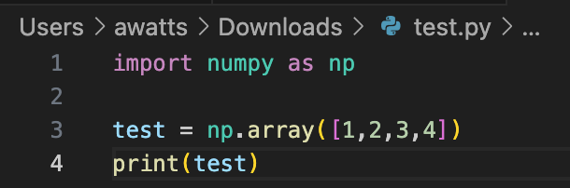
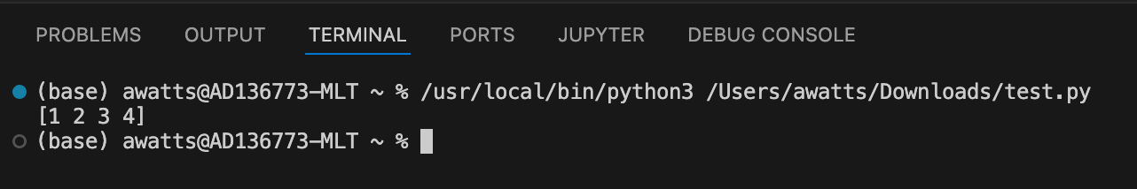
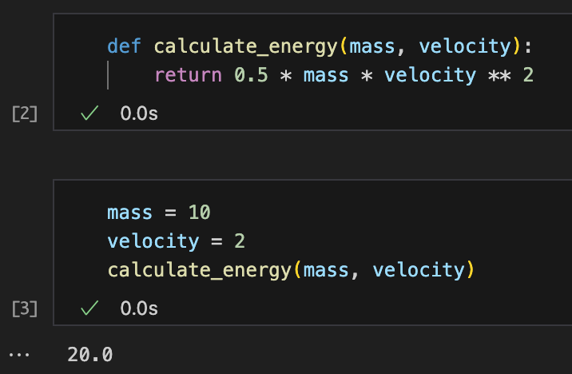
Installation and Runtime: VSCode
VSCode (not the same as Visual Studio Code) is a Microsoft-bulit open-source programming integrated development environment.
Lightweight and highly modular.
“.py” files can execute in a dedicated terminal.
“.ipynb” notebooks run natively in VSCode.
https://code.visualstudio.com/download

Slide 12
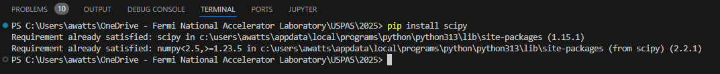
Library Installation in VSCode
In the upper-right of VSCode, chose the view mode that includes a panel at the bottom of the window; alternatively, use CTRL+J on Windows.
Select the “TERMINAL” tab in the bottom pane.
Use “pip install <library name>” to install libraries in the Python environment that’s currently active.

Slide 13
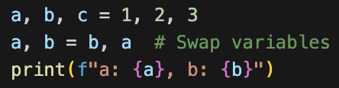
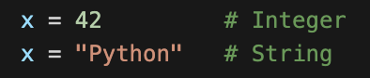
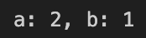
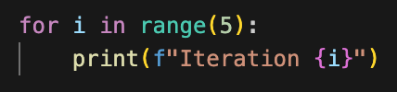
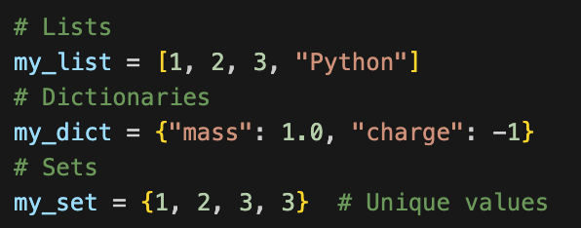
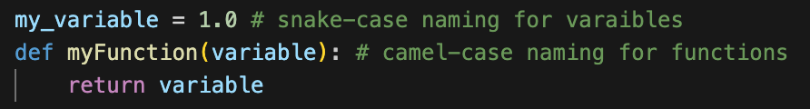
Fundamental Syntax and Structure
Multiple variables may be assigned in a single line for compactness. A single line may also swap values between variables.
Python is a “dynamically-typed” language, which means that variable can be defined without explicitly declaring their type.
Python has several built-in data structures. Lists may contain any combination of variable types.
Dictionaries are relational lists that use keys to identify elements.
Sets are lists whose elements are unique values.
Unlike C-like language, Python uses indentation white space instead of brackets to enforce structure. Make sure you are consistent in using either tabs or multiple spaces for indentation.
By convention, Python variables are named with “snake_case”, and functions with “camelCase”.

Slide 14
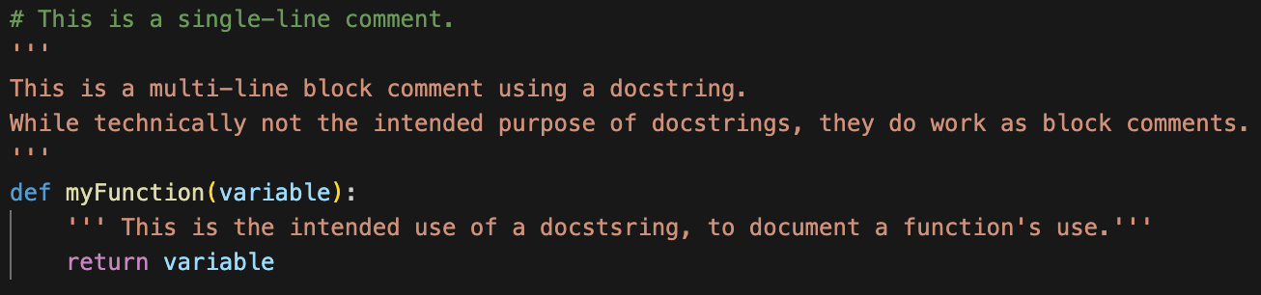
Comments and Docstrings
Python single-line comments use a “#” symbol at the start of the line.
Docstring commends begin and end with three single quotes, denoting documentation for the purpose and use of a function.
While Python officially lacks any block or multi-line comment characters, the “docstring” technically serves the same function. Be warned that some IDEs and automatic documentation packages capture docstrings to document functions, so misuse of the docstring as a block comment may cause issues.

Slide 15
Strings and Formatting
https://mkaz.blog/working-with-python/string-formatting

Slide 16
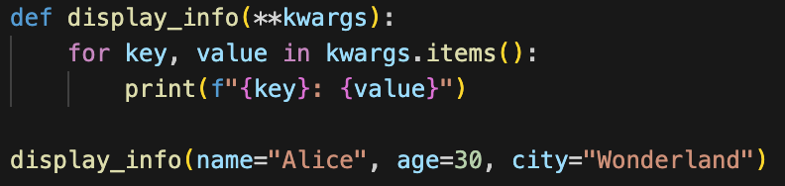
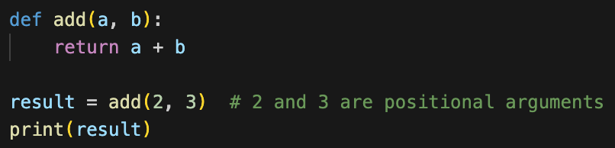
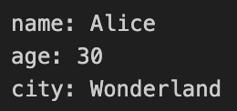
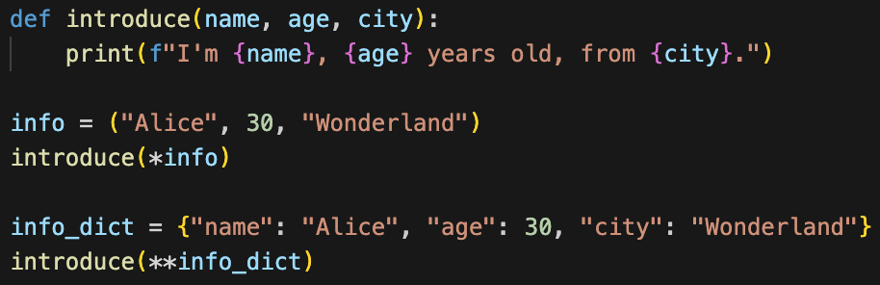
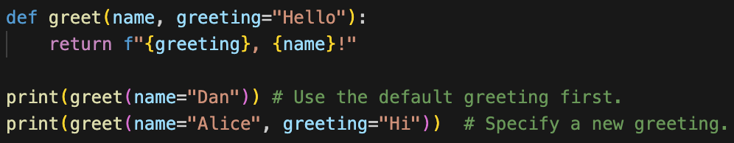
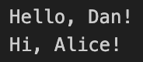
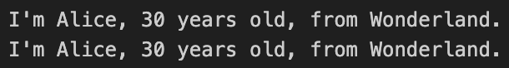
Functions and Arguments
Arbitrary keyword arguments pass any number of keyword arguments as a dictionary.
Positional arguments are passed in the same order that they appear in the function definition.
Iterables may be unpacked into arguments using * for sequences and ** for dictionaries.
Keyword arguments are passed with explicit parameter names, allowing flexibility in the order in which they are specified and used. Note here that we also show how an argument may be specified with a default value.

Slide 17
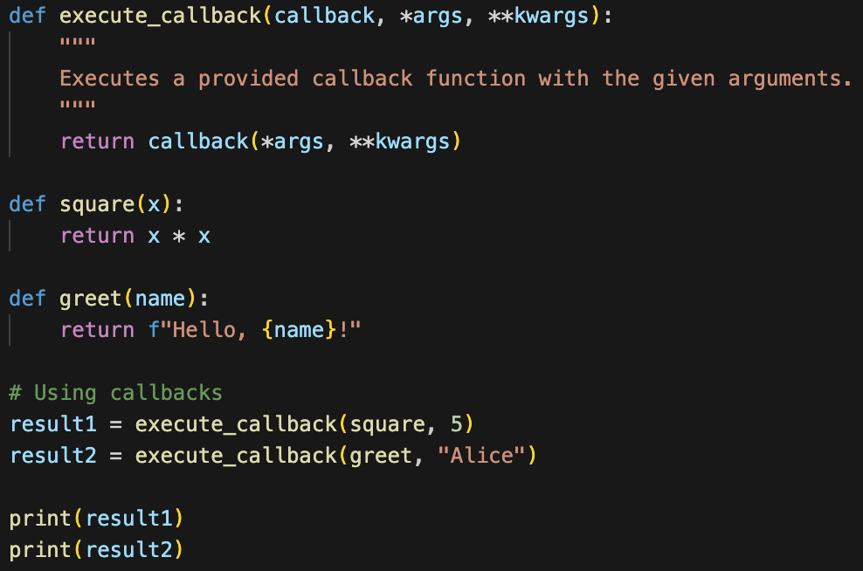
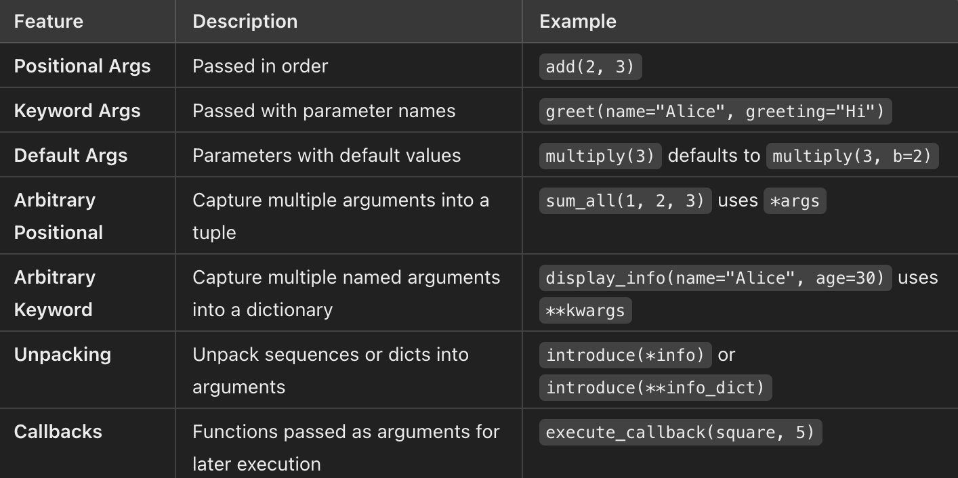
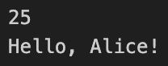
Callback Functions, Argument Summary
A callback is a function that is passed into an argument to another function to be executed at a later point. Callbacks are commonly used in asynchronous programming, event handling, or when customizing a function’s behavior.
Below is a summary of the different methods for passing arguments to Python functions.

Slide 18
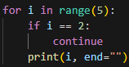
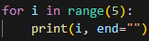
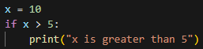
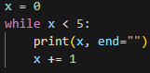
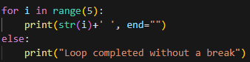
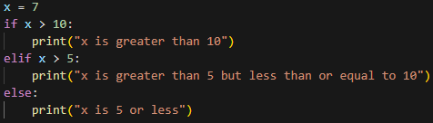
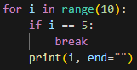
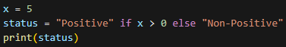
Control Structures
Continue skips the current iteration and proceeds to the next.
Control structures control the execution sequence of blocks of code.
For loops iterate over sequences like lists, tuples, strings, or ranges.
The if structure executes any code within its scope if the specified conditional is True.
Else executes code after the loop finishes, but not if the loop exist with a break.
While loops execute code as long as the condition is True.
An else structure added to if specifies code to execute otherwise. Multiple else structures may be stacked.
Break statements prematurely exit the loop.
Ternary operators are single-line compact logic statements.

Slide 19
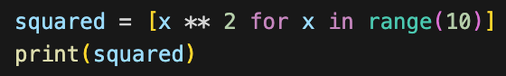
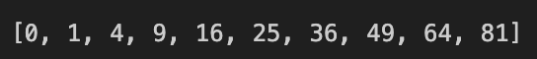
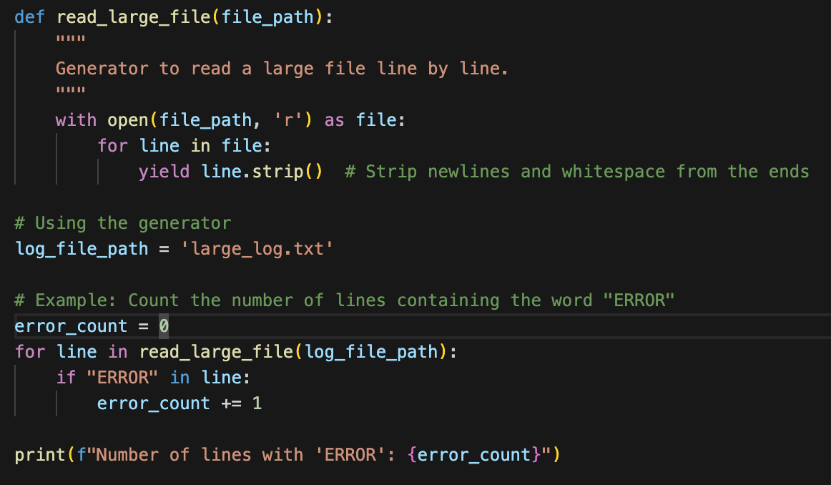
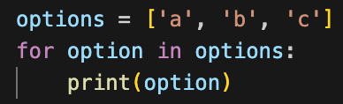

List Comprehension, Iterators, and Generators
“List comprehension” allows for compact definition of list elements in a single line.
A generator function is a special type of function that returns an iterator object. Instead of using “return” to send back a single value, generator functions use “yield” to produce a series of results over time.
Generator functions are highly memory-efficient when working with large datasets and files.
Iterators are a compact and efficient way to loop through a data structure’s elements.

Slide 20
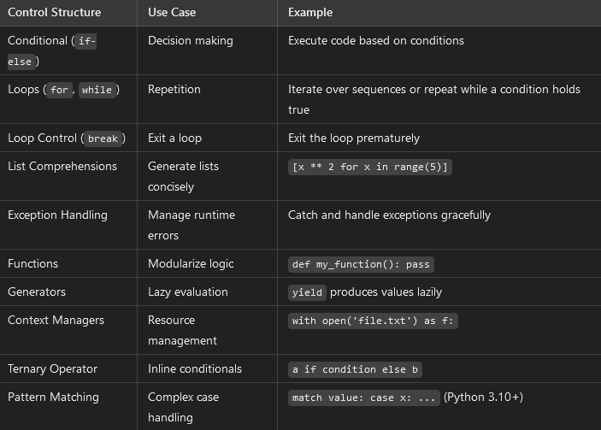
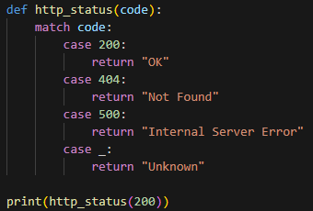
Match-case and Control Structures Summary
Pattern matching control structures using the match and case keywords are analogous to switch-case structures in other languages like C.

Slide 21
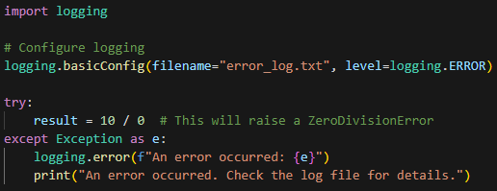
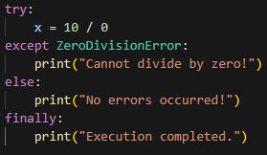
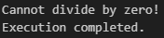
Exception Handling
If a script needs to run continuously and unmonitored, it’s important to make sure it fails gracefully if an unexpected situation or error occurs. These situations are called “exceptions”, and the process of specifying safe behavior in their event is known as “exception handling” or “exception catching”.
Proper exception handling prevents program crashes and creates specific behavior in the event of an error, such as writing information to a log file.
Basic example of exception handling that captures information in a log file.
Basic usage of try, except, else, and finally keywords for a specific error case.
From the log file:

Slide 22
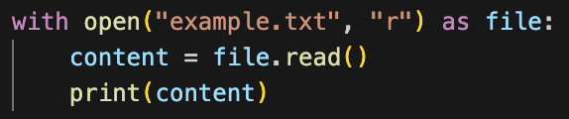
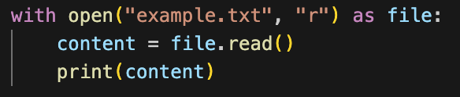
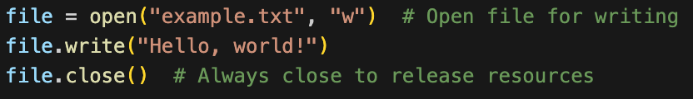
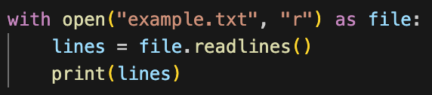
File Reading
Using the context management with statement ensures that the file is properly closed automatically, even if an error occurs during its processing.
Use the built-in open() function to work with files. Several different modes can be passed to this function to modify its behavior:
‘r’: Read (default)
‘w’: Write (overwrites existing content in file)
‘a’: Append (add without overwriting previous content)
‘b’: Binary (write to a binary-format file)
‘x’: Create (creates a new file, fails if it already exists)
Use read() to pull the entire contents of a file into a string. This is useful for small files when all data is needed at once, though post-processing of the string is often needed.
Use readlines() to generate a list of the lines in a file.

Slide 23
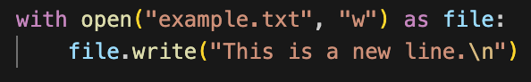
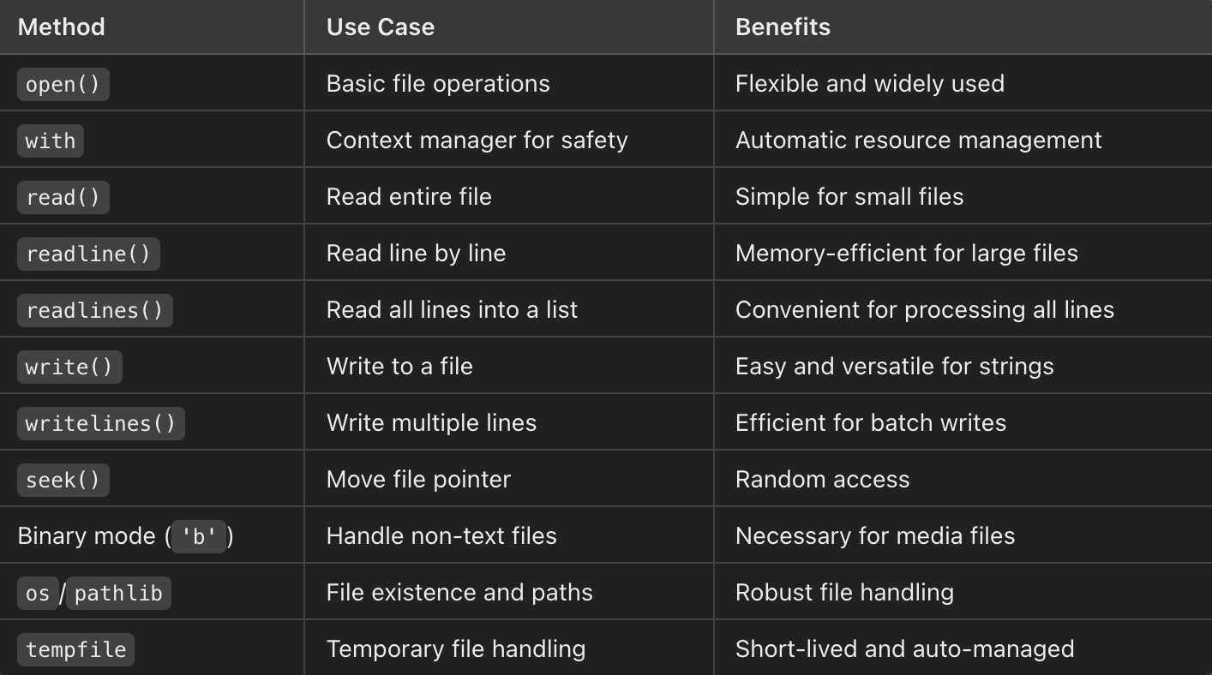
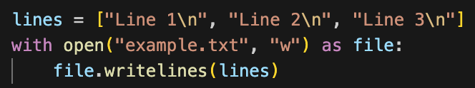

File Writing, I/O Summary Table
Use write() to write strings to a file.
Below is a summary table of built-in Python file input/output functions, their use case, and benefits.
Use writelines() to write a list of strings as multiple lines.
Use write() with the ‘a’ mode to append to the end of a file without erasing already-existing content.

Slide 24








Python Pitfalls
Incorrect default parameter initialization: Default parameters are only evaluated once when a function is first called, not every time.
Mutable default arguments: List or dictionary changes made inside a function persist across function calls, which can lead to unexpected behavior.
Accidental variable shadowing: Reusing generic variable names in nested scopes can cause confusion.
Instead, use the None keyword to initialize inside the function definition.
Mitigate this by using the None keyword as the default argument, and initialize the data structure inside the function.
The solution is simple: avoid re-using variable names, opting for descriptive and unambiguous names instead.

Slide 25
Python Best Practices: Virtual Environments
A Python virtual environment is an isolated environment that allows you to run and manage Python projects with their own dependencies, packages, and versions, separate from the global Python installation.
Dependency Management: Different projects may require different versions of libraries or packages. Virtual environments help manage these dependencies without conflicts.
Isolation: Each virtual environment is isolated from others, preventing changes in one environment from affecting another.
Reproducibility: By using a requirements.txt file, you can easily recreate the same environment on a different machine or share it with others, ensuring that the same versions of packages are used.
To create a virtual environment, you can use the venv module which comes pre-installed with Python 3.3 and above:
python -m venv myenv
This command creates a directory named myenv containing the virtual environment. To activate the environment:
Windows: myenv\Scripts\activate
MacOS and Linux: source myenv/bin/activate
Once the environment is activated, install Python libraries with the usual pip install package_name command. Use deactivate to exit the environment.
To write a text file consisting of the libraries for a given environment and their versions, use pip freeze > requirements.txt.
Recreate the environment later on any machine or directory by transferring requirements.txt and running pip install -r requirements.txt.
For information on using Virtual Environments in VSCode, see: https://code.visualstudio.com/docs/python/environments

Slide 26


Python Best Practices: List Comprehensions are Faster
Use list comprehensions in place of loops for faster, compact code that is “easier to read”.
Here we use the timeit library to compare the execution time of two functions performing the same task with different methods to illustrate the efficiency difference..

Slide 27


Python Best Practices: Importing Libraries and Function Documentation
When importing libraries, avoid the wildcard method, which pulls all functions from the library into the main namespace and may collide with other libraries if they have identically-named functions.
Use docstrings to clearly document the purpose, behavior, and usage of a function. Modern development and documentation systems automatically parse docstrings to generate user documentation.

Slide 28


Python Idiosyncrasies: Duck Typing
Duck typing: Python focuses on behavior rather than explicit types. A function works as long as the object has the required method. If it looks like a duck, and sounds like a duck, it may as well be a duck.
In this example, the function does not check the data type of the input. Rather, it assumes that the input is iterable. This works for any iterable input such as lists, tuples, generators, or user-defined iterables. The output of the example is, as expected:
If the input is not iterable, the interpreter throws a TypeError exception.

Slide 29


Numpy: Numerical Python
NumPy is a powerful Python library for numerical computing. It provides support for large, multi-dimensional arrays.
Multidimensional Arrays: Supports n-dimensional array objects (ndarray), which are highly efficient for numerical operations.
Vectorized Operations: Operations on entire arrays without explicit loops.
Broadcasting: Handles operations on arrays of different shapes intelligently.
Built-in Mathematical Functions: Includes functions for linear algebra, random number generation, Fourier transforms, and more.
Performance: Written in C, making it faster than pure Python loops for numerical tasks.

Slide 30








NumPy: Numerical Python
Advanced indexing and slicing of arrays.
Element-wise operations with compact notation, highly-optimized.
Matrix multiplication
Broadcasting automatically handles operations on arrays with different shapes.

Slide 31

NumPy Performance Comparison
Compare the execution time for the same calculation between NumPy and built-in Python functions.
Note a significant reduction in execution time for the same calculation and same result when using NumPy.

Slide 32

Pyplot
Matplotlib is a powerful plotting library for Python.
Pyplot is the module within that provides a MATLAB-like interface for creating static, animated, and interactive plots.
Ease of Use: Offers a simple interface for creating plots similar to MATLAB.
Versatility: Supports a wide range of plot types like line plots, scatter plots, histograms, 3D plots, etc.
Customization: Highly customizable with options for labels, titles, legends, colors, grid lines, etc.
Integration: Integrates seamlessly with NumPy, Pandas, etc.

Slide 33


Pyplot examples: Line and Scatter Plots

Slide 34


Pyplot examples: Line and Scatter Plots

Slide 35


Pyplot examples: Heatmap

Slide 36


Pyplot examples: Line and Scatter Plots

Slide 37


Pyplot examples: Line and Scatter Plots

Slide 38


Pyplot examples: Line and Scatter Plots

Slide 39


Pyplot examples: Line and Scatter Plots

Slide 40


Pyplot examples: 3D Surface Plot

